Slide 1
SENG 401 - Group 26
UFlourish
Authors & Contributors:
Kairos Koh Jia Jun (30201952)
Simrat S. Benipal (30129328)
Luis Miranda (30053613)
Rei Tsunemi (30121202)
Muhammad Ahsan Zia (30121304)
Chun-chun Huang (30112677)
Shabit Hassan (30062679)
Notes:
Simrat

Slide 2
Contents
Objective/Motivation
Requirements (Use Cases)
Architecture
Design Artifacts
Test Cases
Q&A
Notes:
Simrat

Slide 3
1. Objective/Motivation
The University of Calgary’s Wellness Center (WC), a primary healthcare resource for many university affiliates, presents a highly unique combination of administrative use cases for which a growing combination of technologies has been gradually implemented.
Current technological setup remains beset by a variety of inefficiencies and impracticalities, to the detriment of both administrative workflow and client satisfaction.
In light of these concerns, we propose the development of uFlourish, a centralized software platform capable of effectively managing the WC’s client interaction needs.
We hope for this platform to inspire the development of similar computational solutions to enhance student experience for years to come.
Notes:
Luis

Slide 4
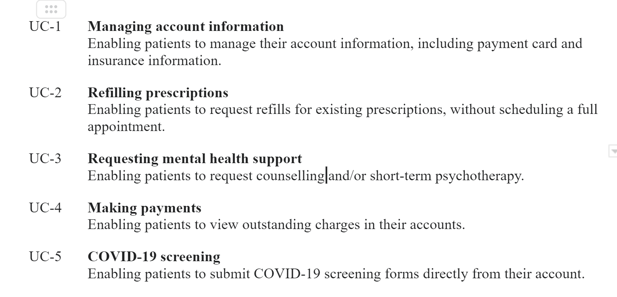
2. Requirements (Use Cases)
Notes:
Ahsan

Slide 5
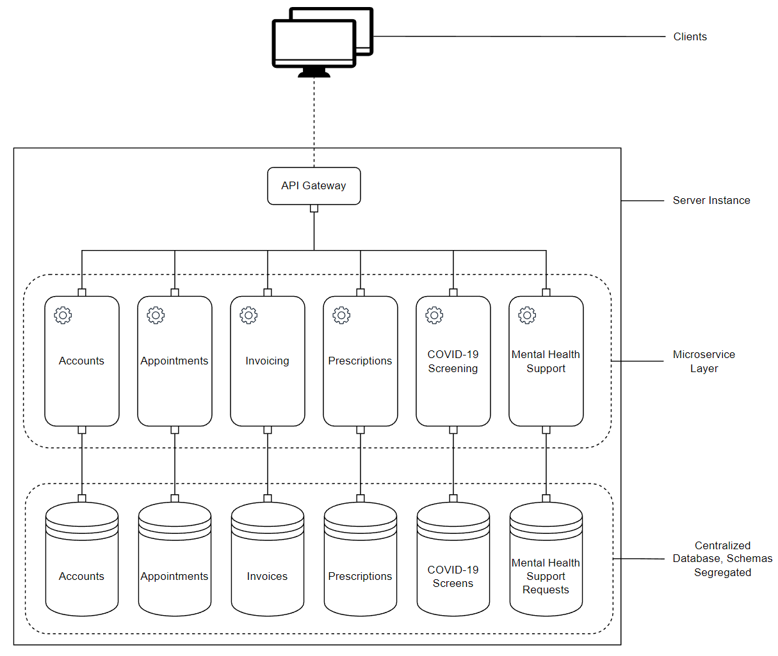
3. Architecture(microservice-like MVC)
Notes:
Charles

Slide 6
4. Design Artifacts
Class Diagram (Slide 7)
Sequence Diagram : Personal Information (Slide 8), Requesting Mental Health Support (Slide 9), User Financials (Slide 10), Refill Prescription (Slide 11), Covid Form (Slide 12)

Slide 7
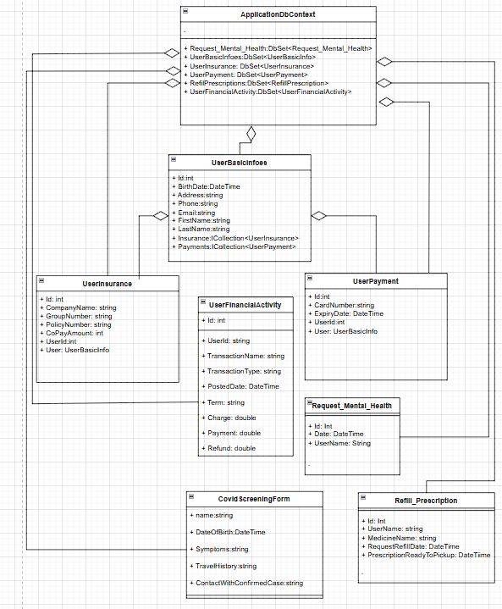
Class
Diagram
Notes:
Charles

Slide 8
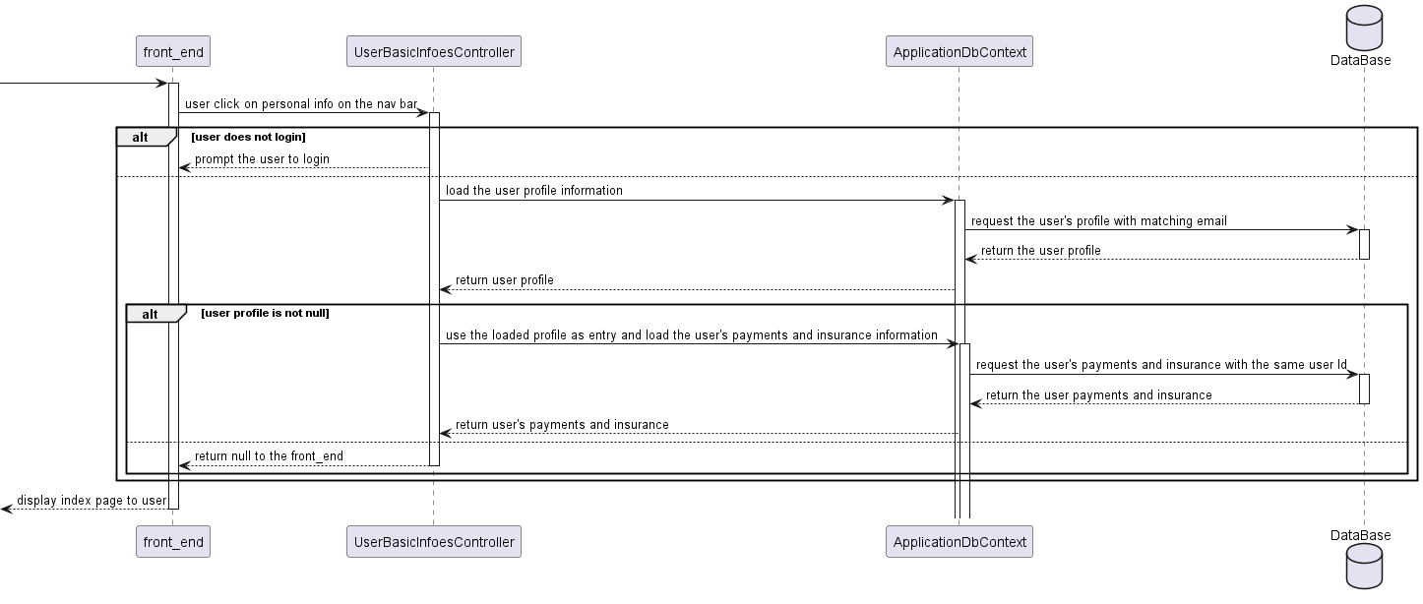
Sequence diagram: Personal information
Notes:
Charles

Slide 9
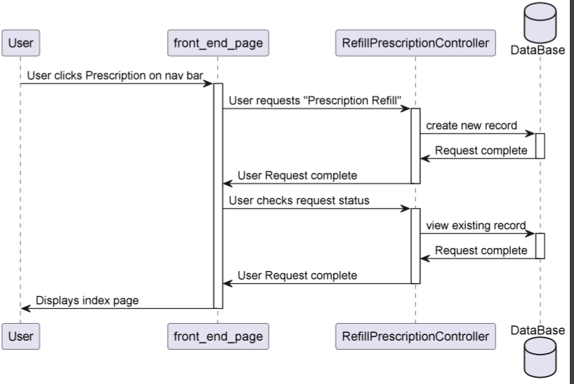
Sequence Diagram: Refill Prescription
Notes:
Luis

Slide 10
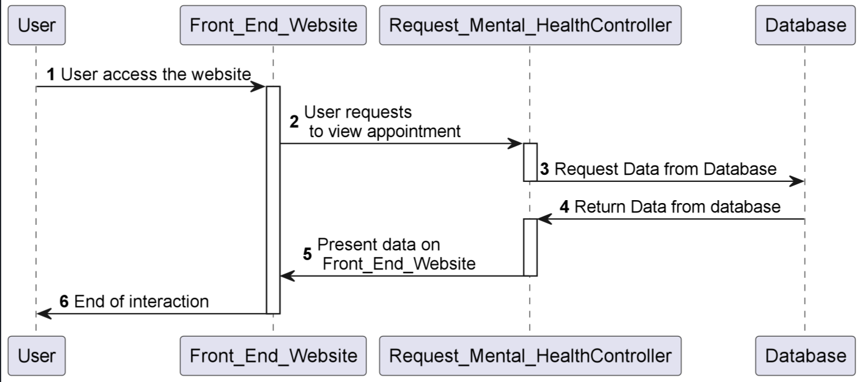
Sequence Diagram: Requesting Mental Health Support
Notes:
Simrat

Slide 11
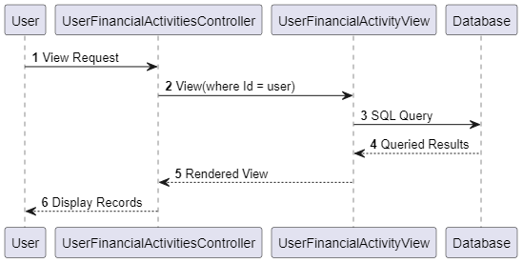
Sequence Diagram: User Financials
Notes:
Kairos

Slide 12
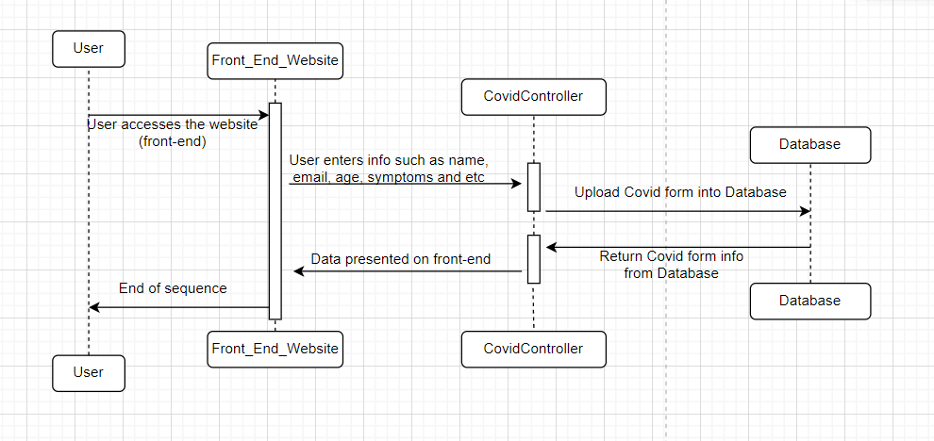
Sequence Diagram: Covid Form
Notes:
Ahsan

Slide 13
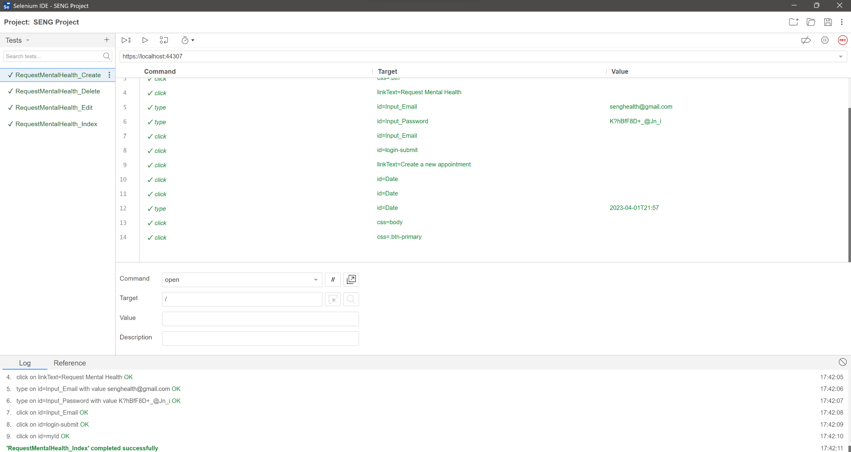
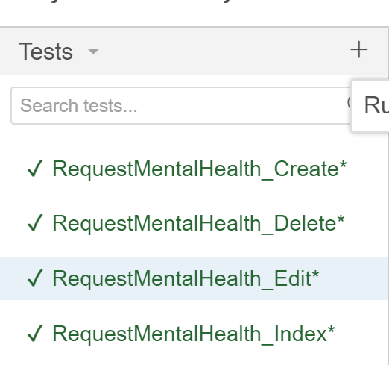
5. Test Cases using Selenium
Notes:
Kairos

Slide 14
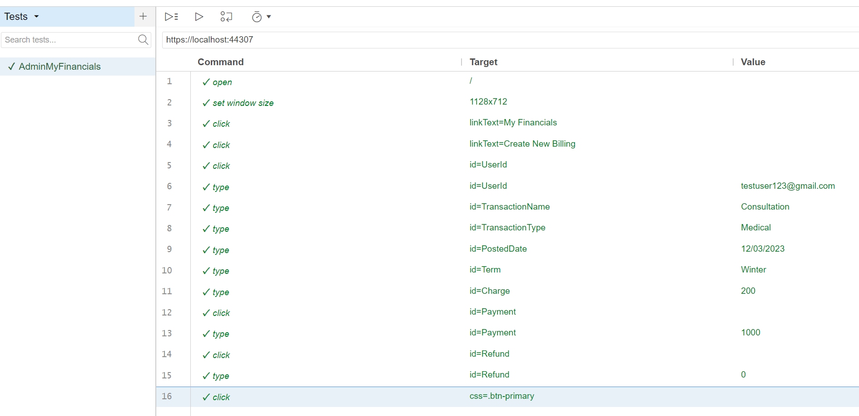
My Financials
Notes:
Kairos

Slide 15
Thank You :)

